Slide 1
CSE 280 Discrete Mathematics
William Clements
Probability Mon 12.1 - 12.2
Conditional Probability Wed 12.3
Bayes Theorem Fri 12.4

Slide 2
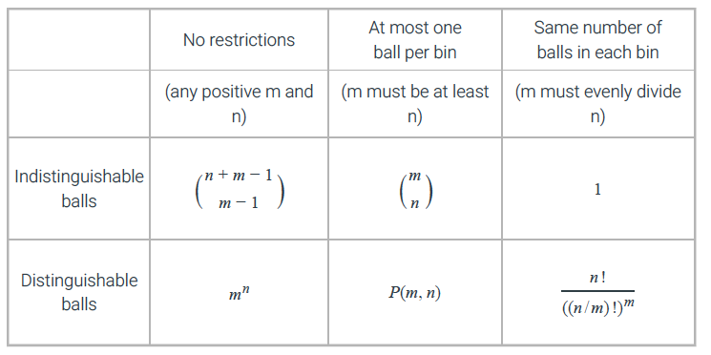
review

Slide 3
Applications
Genetics – Inheritance Traits and other applications
Complexity of algorithms...determining average case complexity
Machine learning
Classification based on probability...such as whether an incoming email message is spam or not spam
Probabilistic algorithms – solve problems not solvable by deterministic algorithms
Instead of following the same steps, a probabilistic algorithm makes one or more random choices, which lead to different outputs.
Simulation and testing with randomized models
Diagnostic test accuracy

Slide 4
Discrete vs Continuous Probability
Discrete probability deals with finite or countably infinite sets
Countably Infinite – There is a one-to-one correspondence between elements of the set and the integers.

Slide 5
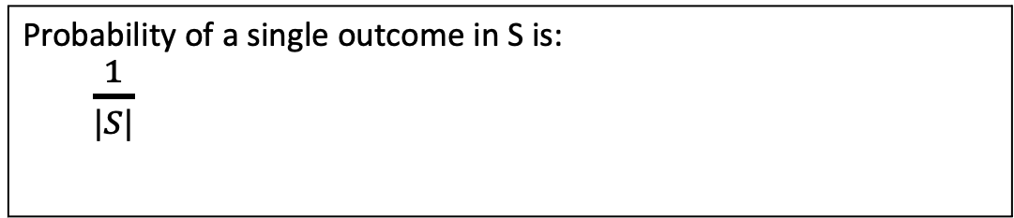
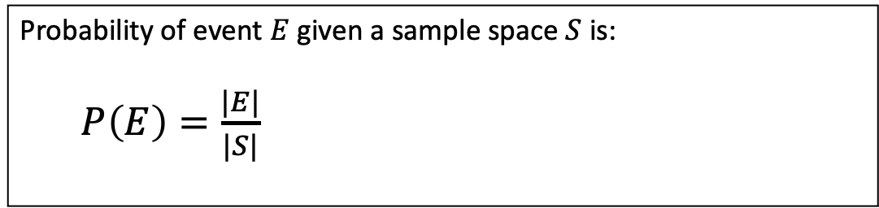
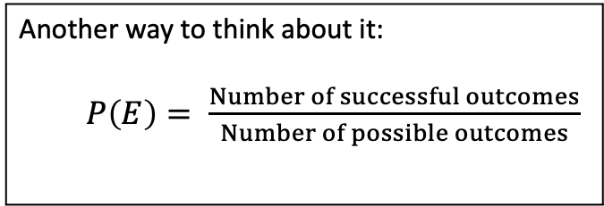
Probability - Introduction
Simplest definition of probability is when all outcomes are equally likely.
Assuming all outcomes in the sample space are equally likely.
Experiment – A procedure that yields one outcome.
Sample Space – The set of all possible outcomes.
Event – A subset of the sample space. A set of outcomes.
Probability of event $E$ given a sample space $S$ is:
$P\left(E\right)=\frac{|E|}{|S|}$
This is known as the Laplace definition of probability
The probability of an event is a number between 0 and 1
Another way to think about it:
$P\left(E\right)= \frac{Number of successful outcomes}{Number of possible outcomes}$
Probability of a single outcome in S is:
$\frac{1}{|S|}$
Rosen, Kenneth. Discrete Mathematics and Its Applications, 7th Edition. McGraw-Hill, 2012

Slide 6
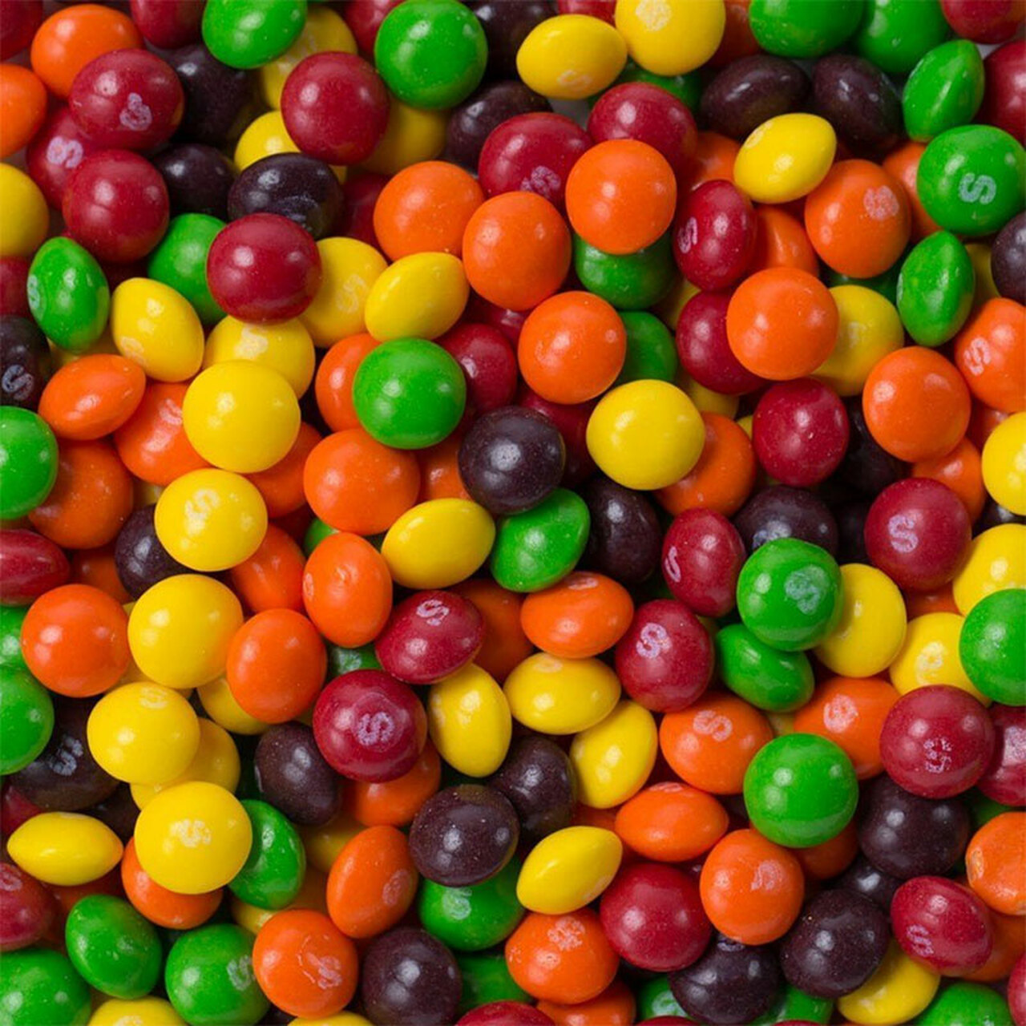
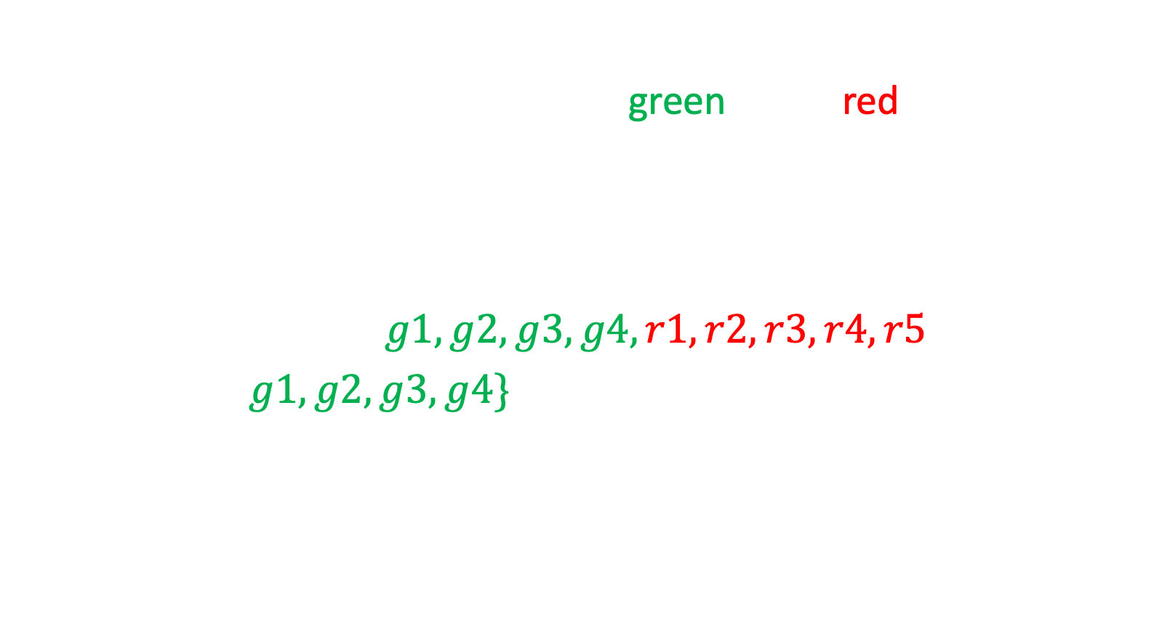

Example:
Suppose a jar contains 9 Skittles, 4 green and 5 red. What is the probability that a randomly chosen Skittle will be green?
Assume each skittle is equally likely to be chosen.
Sample space: $S=\{g1, g2, g3, g4, r1, r2, r3, r4, r5\}$
Event: $E=\{g1, g2, g3, g4\}$
$P\left(E\right)=\frac{\left|E\right|}{\left|S\right|} =\frac{4}{9}= 0.444444…$
All possible outcomes.
A subset of the sample space. Each represents the outcome of a green skittle.
$P\left(E\right)=\frac{|E|}{|S|}$
Rosen, Kenneth. Discrete Mathematics and Its Applications, 7th Edition. McGraw-Hill, 2012

Slide 7
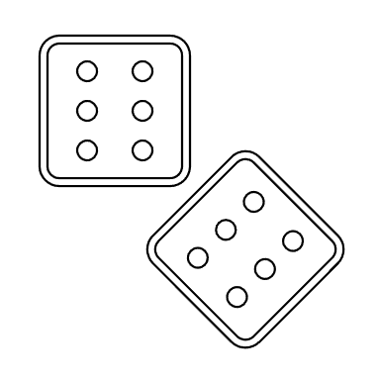

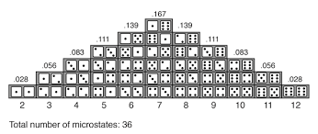



What is the probability that when two dice are rolled, the sum of the dice is 7?
What is the sample space $S$?
$S=\left\{1,2,3,4,5,6\right\}×\left\{1,2,3,4,5,6\right\}=\left\{\left(1,1\right), \left(1,2\right), \left(1,3\right), …,\left(6,5\right), \left(6,6\right)\right\}$
$\left|S\right|=36$
What is the event space?
$E=\left\{\left(1,6\right), \left(2,5\right), \left(3,4\right), \left(4,3\right), \left(5,2\right), \left(6,1\right)\right\}$
$\left|E\right|=6$
$$P\left(E\right)=\frac{\left|E\right|}{|S|}$$
$$=\frac{6}{36}=\frac{1}{6}$$
Python example

Slide 8









What is the probability of correctly guessing a 4-digit number?
How many possible choices?
${10}^{4}=10,000$
This is the size of the sample space.
The size of the event space is 1...the event that the correct number is guessed.
Probability of correctly choosing a single 4-digit number is $\frac{1}{10000}= .0001$
What is the probability of correctly choosing only 3 of the 4 digits?
_ _ _ _
$10⋅ 10⋅10⋅ 10$
_ _ _ _
_ _ _ _
_ _ _ _
_ _ _ _
$$9 ⋅ 1 ⋅ 1 ⋅ 1$$
$$1 ⋅ 9 ⋅ 1 ⋅ 1$$
$$1 ⋅ 1 ⋅ 9 ⋅ 1$$
$1 ⋅ 1 ⋅ 1 ⋅$9
+
+
+
$$P\left(E\right)=\frac{36}{10000}$$
$9+9+9+9 = 36$ways to choose correctly.

Slide 9





Imagine you are participating in a game show where you win $1,000,000 if you correctly guess a set of six numbers between 1 and 40. What are your chances of winning?
There is only one winning set of six numbers, so the size of the event space is 1.
The sample space is the number of ways to choose six numbers out of 40.
$\left({40 \atop 6}\right)=\frac{40!}{6!34!}=\frac{40⋅39⋅38⋅37⋅36⋅35}{6!}=3,838,380$
The probability of correctly choosing the six numbers is
$\frac{1}{3,838,380}≈0.00000026$
What if you have to guess the six numbers in order? (Assume no number will be chosen twice).
$$\frac{1}{P\left(40, 6\right)}=\frac{1}{40∗39∗38∗37∗36∗35}≈0.00000000036$$
$$C\left(n,r\right)=\left({n \atop r}\right)=\frac{n!}{r!\left(n−r\right)! }$$
$$P\left(n,r\right)=\frac{n!}{\left(n−r\right)! }$$
Python example

Slide 10
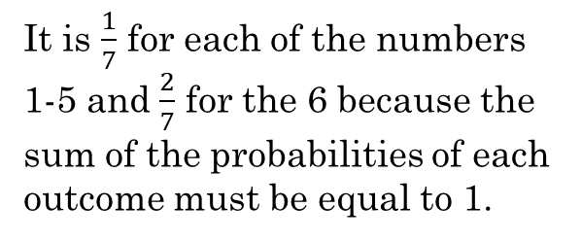
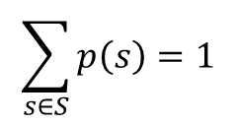
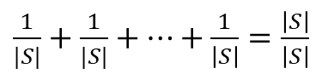

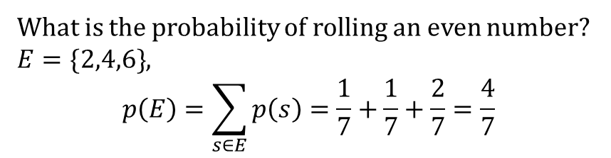
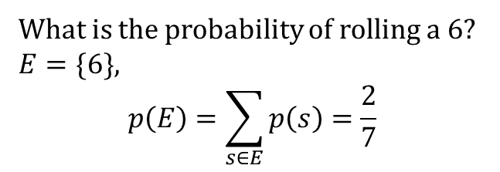
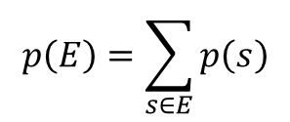
Probability distribution
If we sum up the probability of each outcome in the sample space, the sum is 1.
If each outcome is equally likely, it is a uniform distribution.
Sometimes the probability distribution is not uniform. This happens when some outcomes are more likely than other outcomes.
For example, if a loaded die is crafted in such a way that rolling a 6 is twice as likely as rolling any other number, then the probability distribution is:
$\frac{1}{7}+\frac{1}{7}+\frac{1}{7}+\frac{1}{7}+\frac{1}{7}+\frac{2}{7}=1$
$$\sum_{s∈S}{p\left(s\right)=1}$$
$\frac{1}{|S|}+\frac{1}{|S|}+…+\frac{1}{\left|S\right|}=\frac{\left|S\right|}{\left|S\right|}$
$$p\left(E\right)=\sum_{s∈E}{p\left(s\right)}$$
1 2 3 4 5 6
What is the probability of rolling a 6?
$E=\{6\}$,
$$p\left(E\right)=\sum_{s∈E}{p\left(s\right)=\frac{2}{7}}$$
It is $\frac{1}{7}$ for each of the numbers 1-5 and $\frac{2}{7}$ for the 6 because the sum of the probabilities of each outcome must be equal to 1.
What is the probability of rolling an even number?
$E=\{2,4,6\}$,
$$p\left(E\right)=\sum_{s∈E}{p\left(s\right)=\frac{1}{7}+\frac{1}{7}+\frac{2}{7}}=\frac{4}{7}$$

Slide 11



Try it:
If we flip a fair coin, what probabilities should we assign to the outcomes $H$ and $T$?
Since each outcome is equally likely, and there are two possible outcomes:
$p\left(H\right)=p\left(T\right)=\frac{1}{2}$
$\frac{1}{2}+\frac{1}{2}=1$ The probability of all outcomes sums to 1.
What if heads is twice as likely as tails?
$p\left(H\right)=2⋅p(T)$
What is the probability of each?
$p\left(H\right)+p\left(T\right)=1$
$2⋅p\left(T\right)+p\left(T\right)=3⋅p\left(T\right)=1$
Thus, $p\left(T\right)=\frac{1}{3}$ and $p\left(H\right)=2⋅p\left(T\right)=\frac{2}{3}$

Slide 12
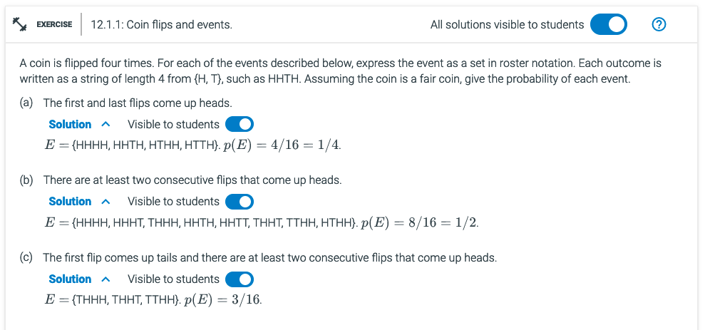
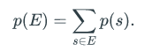
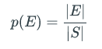
What are the strings?
What is E?

Slide 13
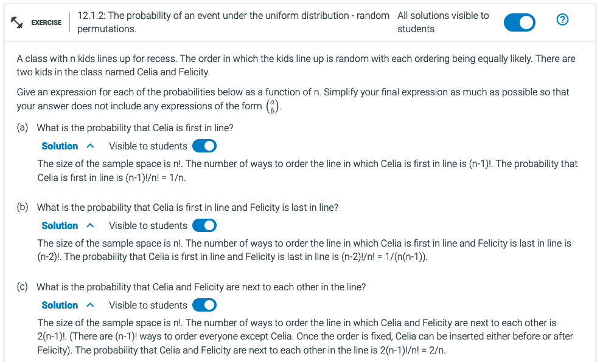

N: What is n?
E: What is Celia?
$P\left(E\right)= \frac{Number of successful outcomes}{Number of possible outcomes}$
E:?
E:?
$$C\left(n,r\right)=\left({n \atop r}\right)=\frac{n!}{r!\left(n−r\right)! }$$

Slide 14
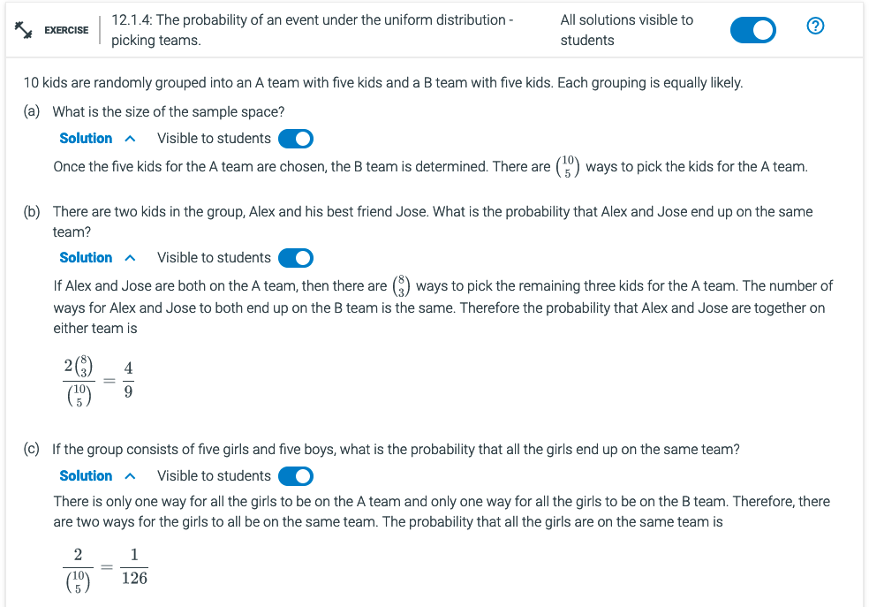

$$C\left(n,r\right)=\left({n \atop r}\right)=\frac{n!}{r!\left(n−r\right)! }$$

Slide 15
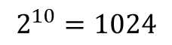

Using the complement of a probability.
$P\left(\overline{E}\right)=1 −P(E)$
Suppose we randomly generate a sequence of 10 bits. What is the probability that at least one of these bits is a 1?
Note it is easier to find the probability that none of the bits is a 1. There is only one case where none of the bits is a 1: 0000000000
$E=\{0000000000\}$ and $P\left(E\right)=\frac{\left|E\right|}{\left|S\right|}=\frac{1}{2^{10}}=\frac{1}{1024}$
$\overline{E}=\{all bitstrings containing at least one 1\}$ (the opposite of $E$)
$P\left(\overline{E}\right)=1−P\left(E\right)=1 −\frac{1}{1024}=\frac{1023}{1024}$
0000000000
0000000001
0000000010
...
1111111110
1111111111
$$2^{10}=1024$$

Slide 16
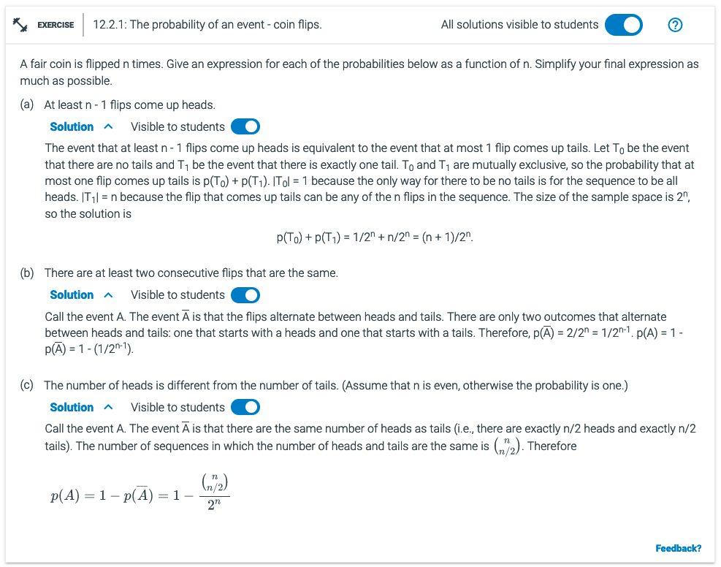

Remember
P(!E) = 1- P(E)
What is n? Given n-1, the 2^{n}.
What is 1-P(E)?
What does ”at least n-1” mean?
P(T) + P(H) = 1
Two flips are the same: TT HH
Out of n flips.
Remember 2*2^{(n-1)}.
!E – same number of heads and tails
C(n, n/2) – n/2 half of each flip
What is !E?
$P\left(E_{1}∪E_{2}\right)=P\left(E_{1}\right)+P\left(E_{2}\right)−P\left(E_{1}∩E_{2}\right)$
$P\left(E\right)= \frac{Number of successful outcomes}{Number of possible outcomes}$

Slide 17
N:?
E:?
$P\left(E\right)= \frac{Number of successful outcomes}{Number of possible outcomes}$
$P\left(E_{1}∪E_{2}\right)=P\left(E_{1}\right)+P\left(E_{2}\right)−P\left(E_{1}∩E_{2}\right)$
$$P\left(\overline{E}\right)=1−P\left(E\right)$$

Slide 18
Solve the following using Python:
A coin is flipped four times. For each of the events described below, express the event as a set using roster notation. Each outcome in the sample space can be written as a string of length 4 from {H, T}, such as HHTH. Assuming the coin is a fair coin, give the probability of each event.
The first and last flips come up heads.
There are at least two consecutive flips that come up heads.
The first flip comes up tails and there are at least two consecutive flips that come up heads.
Python example

Slide 19
Additional Exercises:
12.1.1
12.1.2
12.1.4
12.2.1

Slide 20

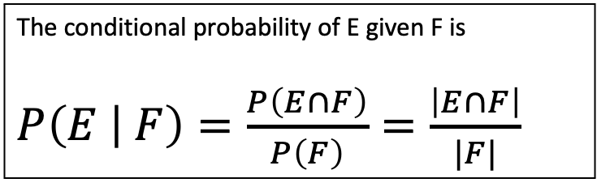
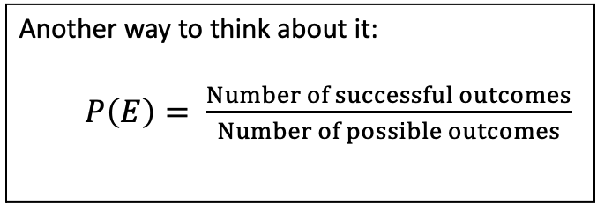
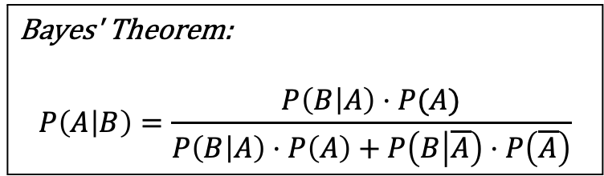
Another way to think about it:
$P\left(E\right)= \frac{Number of successful outcomes}{Number of possible outcomes}$
Review
What we are covering next:
Probabilities for unions of events
Conditional Probability
Mutual independence
Bayes' Theorem
Using the complement of a probability.
$P\left(\overline{E}\right)=1 −P(E)$
$P\left(E_{1}∪E_{2}\right)=P\left(E_{1}\right)+P\left(E_{2}\right)−P\left(E_{1}∩E_{2}\right)$
The conditional probability of E given F is
$P\left(E | F\right)=\frac{P\left(E∩F\right)}{P\left(F\right)}=\frac{\left|E∩F\right|}{|F|}$
$P\left(E_{1}∩E_{2}∩…∩E_{n}\right)=P\left(E_{1}\right)⋅P\left(E_{2}\right)⋯P\left(E_{n}\right)$
Bayes' Theorem:
$$P\left(A | B\right)=\frac{P\left(B | A\right)⋅P(A)}{P\left(B | A\right)⋅P\left(A\right)+P\left(B | \overline{A}\right)⋅P\left(\overline{A}\right)}$$

Slide 21



Probabilities for unions of events
$P\left(E_{1}∪E_{2}\right)=P\left(E_{1}\right)+P\left(E_{2}\right)−P\left(E_{1}∩E_{2}\right)$
What is the probability that a randomly chosen number between 1 and 100 (inclusive) is divisible by either 3 or 5?
$E_{1}=\left\{all integers divisible by 3\right\}=\{3,6,9,12,15,…, 99\}$
$E_{2}=\left\{all integers divisible by 5\right\}=\left\{5,10,15,…, 100\right\}$
Note there is some overlap, so we need to remove those outcomes that are counted twice.
$E_{1}∩E_{2}=\left\{15, 30, 45, 60, 75, 90\right\}$ $P\left(E_{1}∩E_{2}\right)=\frac{6}{100}$
$P\left(E_{1}∪E_{2}\right)=\frac{33}{100}+\frac{20}{100}−\frac{6}{100}=\frac{47}{100}= .47$
$$P\left(E_{1}\right)=\frac{33}{100}$$
$$P\left(E_{2}\right)=\frac{20}{100}$$
Python example

Slide 22
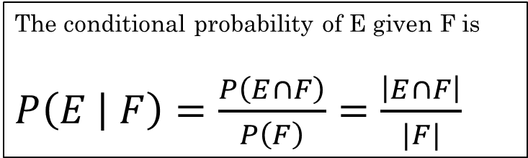

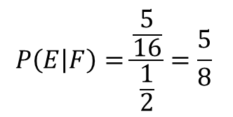
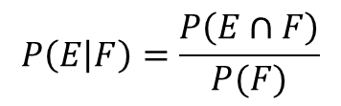

Conditional Probability
$P\left(E\right)= \frac{Number of successful outcomes}{Number of possible outcomes}$
The conditional probability of E given F is
$P\left(E | F\right)=\frac{P\left(E∩F\right)}{P\left(F\right)}=\frac{\left|E∩F\right|}{|F|}$
*As long as the distribution is uniform
Randomly generate a bit string of length four. Each outcome is equally likely.
What is the probability that it contains at least two consecutive 0's?
What if we know the first bit is a 0? Does that change the probability?
Now we are looking for the probability of two consecutive 0's given the first bit is a 0.
We have a different sample space. Now our possible outcomes only include those that start with a 0.
$F=$ first bit is a 0, $\left|F\right|=\frac{8}{16}=\frac{1}{2}$
$S=\{0000, 0001, 0010,…, 1111\}$ $\left|S\right|=16$
$$P\left(E | F\right)=\frac{P\left(E∩F\right)}{P(F)}$$
$E=\{0000, 0001, 0010, 0011, 0100, 1000, 1001, 1100\}$ $\left|E\right|=$ 8
$P\left(E\right)=\frac{8}{16}=\frac{1}{2}$
$$P\left(E | F\right)=\frac{\frac{5}{16}}{\frac{1}{2}}=\frac{5}{8}$$

Slide 23
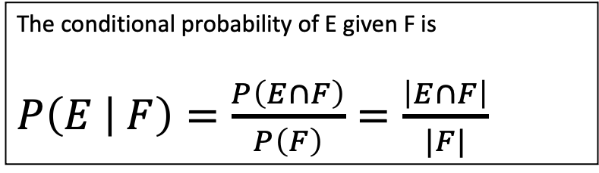



Conditional Probability
$P\left(E\right)= \frac{Number of successful outcomes}{Number of possible outcomes}$
The conditional probability of E given F is
$P\left(E | F\right)=\frac{P\left(E∩F\right)}{P\left(F\right)}=\frac{\left|E∩F\right|}{|F|}$
If we flip a fair coin 3 times, there are 8 possible outcomes:
$S= \left\{HHH, HHT, HTH, HTT, THH, THT, TTH, TTT\right\}$
The probability of each outcome is $\frac{1}{8}$. The size of the sample space $|S|$ is 8.
What is the probability of getting an odd number of tails?
$E=\{HHT, HTH, THH, TTT\}$, so $P\left(E\right)=\frac{\left|E\right|}{|S|}=\frac{4}{8}=\frac{1}{2}$
If we know the first coin flip is a tail, does that change the probability of getting an odd number of tails?
Our sample space has changed. Let's call the new sample space $F$. Then, $F=\left\{THH, THT, TTH, TTT\right\}$
Our new event space, given $F$, is everything that is in $E$ and $F$, which is $E∩F=\{THH, TTT\}$.
$P\left(E | F\right)=\frac{\left|E∩F\right|}{|F|}=\frac{2}{4}=\frac{1}{2}$
What is S?
What is E?
What is F?
What is E $∩$F?
The probability did not change. Why not?

Slide 24
Additional Exercises 12.3.1 – As a class
12.3.2 – Using Python

Slide 25
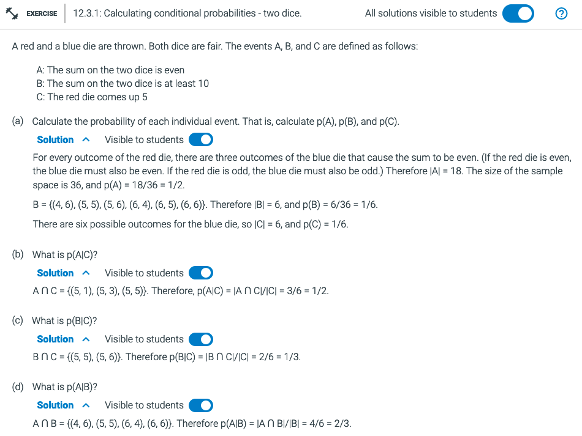
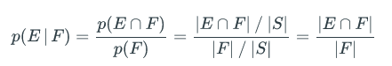
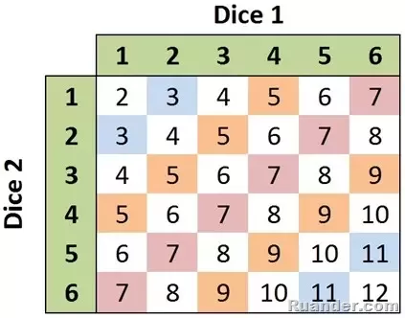


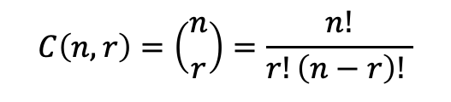

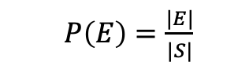


What is S?
What is E?
What is F?
What is E $∩$F?
$$C\left(n,r\right)=\left({n \atop r}\right)=\frac{n!}{r!\left(n−r\right)! }$$
$P\left(E\right)= \frac{Number of successful outcomes}{Number of possible outcomes}$
$P\left(E\right)=\frac{|E|}{|S|}$
$$C\left(n,r\right)=\left({n \atop r}\right)=\frac{n!}{r!\left(n−r\right)! }$$
$P\left(E\right)=\frac{|E|}{|S|}$
$P\left(E\right)= \frac{Number of successful outcomes}{Number of possible outcomes}$

Slide 26

What is S?
What is E?
What is F?
What is E $∩$F?
$$C\left(n,r\right)=\left({n \atop r}\right)=\frac{n!}{r!\left(n−r\right)! }$$
$P\left(E\right)= \frac{Number of successful outcomes}{Number of possible outcomes}$
$P\left(E\right)=\frac{|E|}{|S|}$
A = {…}
B = {…}
C = {…}
$P\left(E\right)= \frac{Number of successful outcomes}{Number of possible outcomes}$

Slide 27
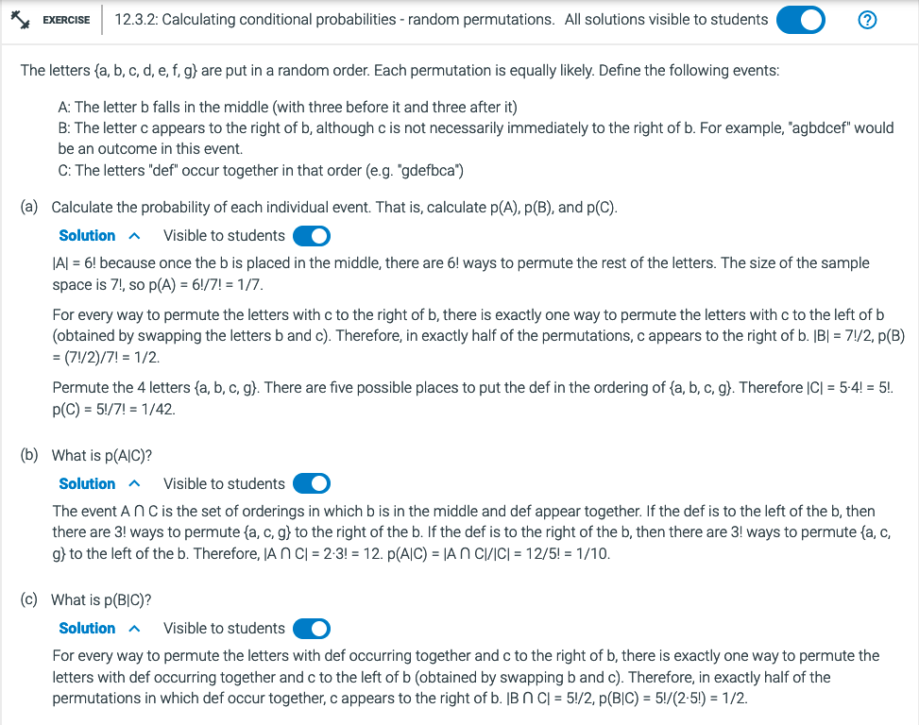
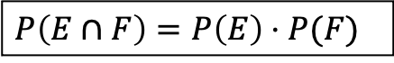
What is S?
What is E?
What is F?
What is E $∩$F?
$$C\left(n,r\right)=\left({n \atop r}\right)=\frac{n!}{r!\left(n−r\right)! }$$
$P\left(E\right)= \frac{Number of successful outcomes}{Number of possible outcomes}$
$P\left(E\right)=\frac{|E|}{|S|}$
$P\left(E∩F\right)=P\left(E\right)⋅P(F)$

Slide 28
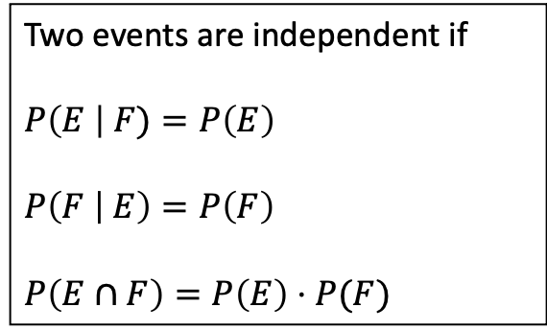

Independent Events
Correlation vs Causation
If $P\left(E \right| F)=P(E)$, then $E$ and $F$ are independent events.
In other words, the probability of event $E$ does not change based on event $F$.
The occurrence of event $F$ does not give any information about event $E$.
We can also say:
Two events are independent if
$P\left(E \right| F)=P\left(E\right)$
$P\left(F | E\right)=P\left(F\right)$
$P\left(E∩F\right)=P\left(E\right)⋅P(F)$
These three conditions are all equivalent.

Slide 29
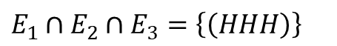

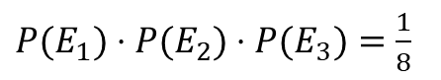

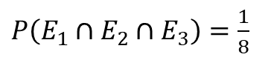
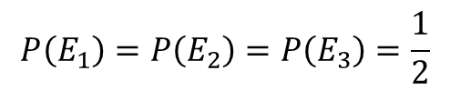
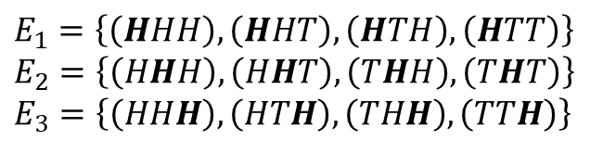
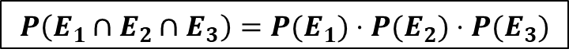
Mutual independence
$P\left(E_{1}∩E_{2}∩…∩E_{n}\right)=P\left(E_{1}\right)⋅P\left(E_{2}\right)⋯P\left(E_{n}\right)$
Example:
$n$ throws of a die where each event $E_{i}$ depends only on the outcome of the $i^{th}$ throw.
Flip a coin three times. $E_{i}$ is the event that the $i^{th}$ throw is a Head.
$S=\{\left(HHH\right),\left(HHT\right), \left(HTH\right), \left(HTT\right),$ $\left(THH\right), \left(THT\right), \left(TTH\right), \left(TTT\right)\}$
$E_{1}=\left\{\left(HHH\right), \left(HHT\right), \left(HTH\right), \left(HTT\right)\right\}$
$E_{2}=\left\{\left(HHH\right), \left(HHT\right), \left(THH\right),\left(THT\right)\right\}$
$E_{3}=\left\{\left(HHH\right), \left(HTH\right), \left(THH\right), \left(TTH\right)\right\}$
$E_{1}∩E_{2}∩E_{3}=\left\{\left(HHH\right)\right\}$
These events are mutually independent because a successful outcome in one event does not depend on the other events.
$P\left(E_{1}∩E_{2}∩E_{3}\right)=\frac{1}{8}$
$$P\left(E_{1}\right)=P\left(E_{2}\right)=P\left(E_{3}\right)=\frac{1}{2}$$
$P(E_{1})⋅P(E_{2})⋅P(E_{3})=\frac{1}{8}$
$$P\left(E_{1}∩E_{2}∩E_{3}\right)=P(E_{1})⋅P(E_{2})⋅P(E_{3})$$

Slide 30
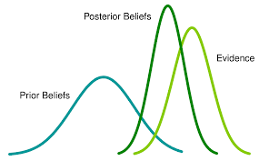
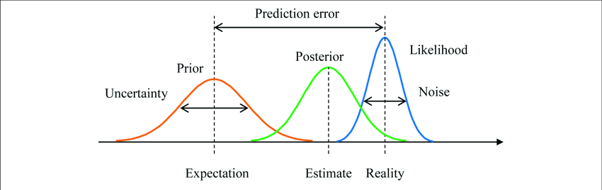
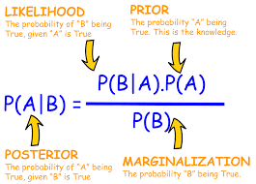
Bayes' Theorem
Helps us find the probability of an event based on partial information.
Used extensively in machine learning and other areas. Spam filters, classifying text, images, etc.
Suppose we have two jars of skittles, Jar A and Jar B. We can't see inside and don't know which is which.
Jar A contains two green skittles and seven red skittles. Jar B contains four green skittles and three red skittles.
You randomly choose a skittle from one of the jars. If the skittle is red, what is the probability you selected from Jar A?

Slide 31
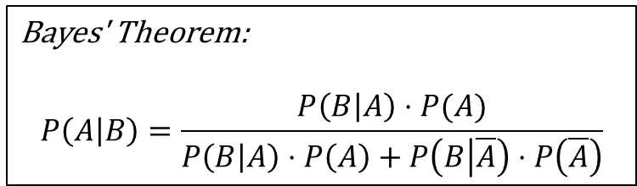
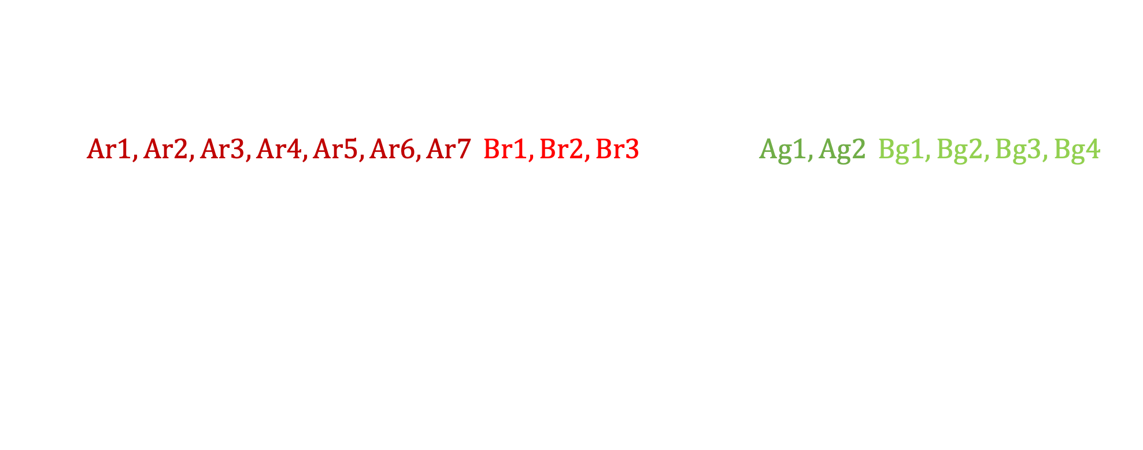

Bayes' Theorem
Bayes' Theorem:
$$P\left(A | B\right)=\frac{P\left(B | A\right)⋅P(A)}{P\left(B | A\right)⋅P\left(A\right)+P\left(B | \overline{A}\right)⋅P\left(\overline{A}\right)}$$
Jar A: 2 green, 7 red Jar B: 4 green, 3 red
You randomly choose a skittle from one of the jars. If the skittle is red, what is the probability you selected from Jar A?
$R=\left\{Ar1, Ar2, Ar3, Ar4, Ar5, Ar6, Ar7, Br1, Br2, Br3\right\}$, $\overline{R}=\left\{Ag1, Ag2, Bg1, Bg2, Bg3, Bg4\right\}$
$A=\{Jar A\}$ $\overline{A}=\{Jar B\}$
We are looking for $P\left(A \right| R)$, the probability we chose from Jar A given a red skittle.
We know the following:
$P\left(R | A\right)=\frac{7}{9}$
$P\left(R | \overline{A}\right)=\frac{3}{7}$
$P\left(A\right)=P\left(\overline{A}\right)= \frac{1}{2}$
Before choosing a red skittle, we assumed the probability that we selected Jar A was 50%. But with the extra information of choosing a red skittle, that probability increased to 64.5%.
Apply Bayes' Theorem:
$$P\left(A | R\right)=\frac{\frac{7}{9}⋅\frac{1}{2}}{\frac{7}{9}⋅\frac{1}{2}+\frac{3}{7}⋅\frac{1}{2}}=\frac{\frac{7}{9}}{\frac{7}{9}+\frac{3}{7}}≈0.645$$
Rosen, Kenneth. Discrete Mathematics and Its Applications, 7th Edition. McGraw-Hill, 2012

Slide 32


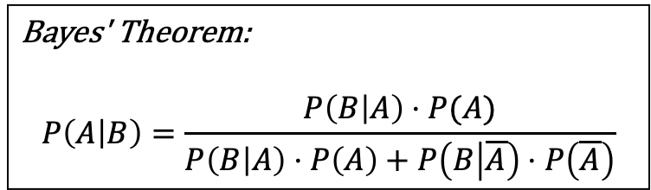
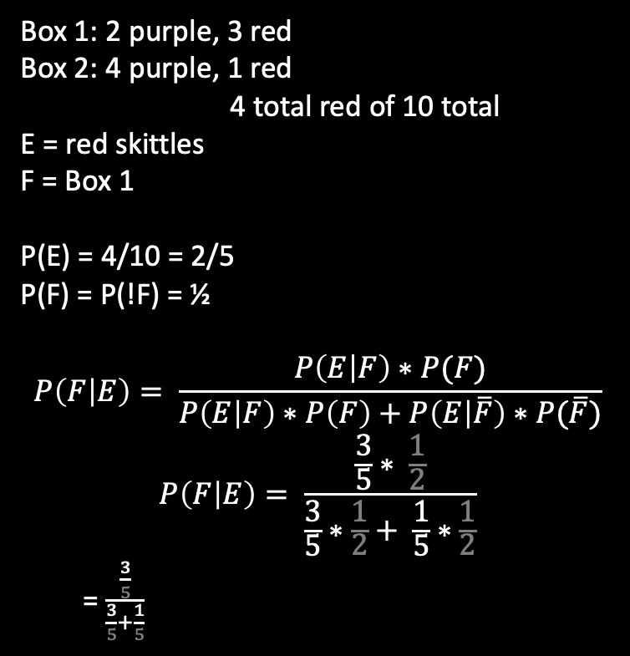
Try it:
Suppose you draw a skittle from one of two boxes that you choose at random. The first box contains two purple skittles and three red skittles. The second box contains four purple skittles and one red skittle.
What is the probability you selected from the first box if you got a red skittle?
Let $E$ represent the event of drawing a red skittle. What is $P\left(E\right)$?
Let $F$ represent the event of choosing from box 1. What is $P\left(F\right)$?
$P\left(E | F\right)= ?$ $P\left(E | \overline{F}\right)= ?$
We want to find $P\left(F | E\right)$.
Box 1: 2 purple, 3 red
Box 2: 4 purple, 1 red
4 total red of 10 total
E = red skittles
F = Box 1
P(E) = 4/10 = 2/5
P(F) = P(!F) = ½
$$P\left(F | E\right)= \frac{P\left(E | F\right)∗P(F)}{P\left(E | F\right)∗P\left(F\right)+P\left(E | \overline{F}\right)∗P(\overline{F})}$$
$$P\left(F | E\right)= \frac{\frac{3}{5}∗ \frac{1}{2}}{\frac{3}{5}∗\frac{1}{2}+ \frac{1}{5}∗\frac{1}{2}}$$
= $\frac{\frac{3}{5}}{\frac{3}{5}+\frac{1}{5}}$
$P\left(F | E\right)=\frac{3}{4}$
Bayes' Theorem:
$$P\left(A | B\right)=\frac{P\left(B | A\right)⋅P(A)}{P\left(B | A\right)⋅P\left(A\right)+P\left(B | \overline{A}\right)⋅P\left(\overline{A}\right)}$$

Slide 33
Additional Exercises
12.3.6
12.4.1
12.4.4

Slide 34
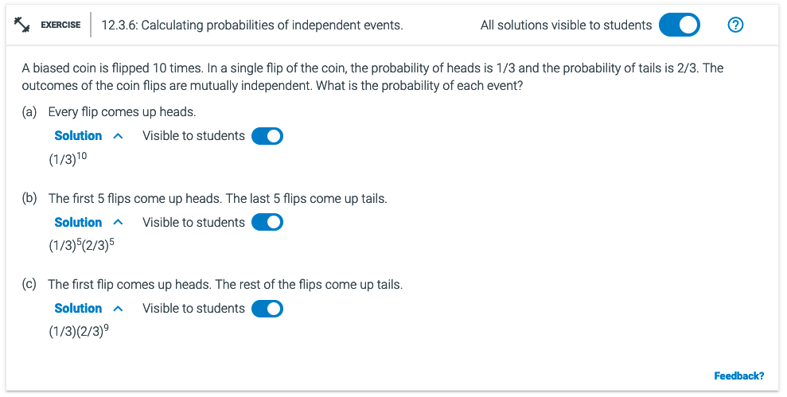

P(H) = ?
P($\overline{H}$) = ?
$P\left(E\right)= \frac{Number of successful outcomes}{Number of possible outcomes}$
P(H) = ?
P($\overline{H}$) = ?

Slide 35




What is P(B|Y)
B – bias coin
Y - 10 flips – random coin
P(B) – chance of picking Bias coin
P($\overline{B}$) – not picking
P(Y|B) – flips with bias coin
P(Y|$\overline{B}) −flips with non bias$
What is P(B|Y)
B – bias coin
Y - 10 flips – random coin
P(B) = 1/2
P($\overline{B}$) = 1/2
P(Y|B) = ${\frac{1}{4}}^{T?} {\frac{3}{4}}^{H?}$
P(Y|$\overline{B})$ = ${\frac{?}{ ? }}^{?}$
Bayes' Theorem:
$$P\left(A | B\right)=\frac{P\left(B | A\right)⋅P(A)}{P\left(B | A\right)⋅P\left(A\right)+P\left(B | \overline{A}\right)⋅P\left(\overline{A}\right)}$$

Slide 36



Bayes' Theorem:
$$P\left(A | B\right)=\frac{P\left(B | A\right)⋅P(A)}{P\left(B | A\right)⋅P\left(A\right)+P\left(B | \overline{A}\right)⋅P\left(\overline{A}\right)}$$
Given:
1. P(D) =
P(!D) = 1- P(D) =
2. False positive
P(T|!D) =
3. False negative P(!T $∩$ D) = 0
P(!T|D) = P(!T $∩$D)/P(D)
= 0
Also known
P(!T|D) + P(T|D) = 1
4. P(T|D) = 1
Known: P(T|D) =
P(D) =
P(T|!D) =

Slide 37
Take Home Exam #3
50 Questions
Section 1-14
No Time Limit

